Slide 1

BRAC UNIVERSITY
GATED RESNET ARCHITECTURE FOR TRANSFORMER Multi-head Attention Block
By
Mubtasim Fuad Mahde (24341116)
Ahnaf Hassan (21341009)

Slide 2
Introduction
Research Objective
Description of the models
Training Environment
Dataset Description
Hyper-Parameters
Evaluation
Result Analysis
BLEU Score
Effect of Sparsity
Effect of Multiple ResNet
Efficiency of Models
Limitations
Future Research
Conclusion
BRAC UNIVERSITY
OVERVIEW

Slide 3
INTRODUCTION
REPLACING EXISTING RNN AND CNN SOLUTIONS
ALLOWING PARALLEL PROCESSING
EXCELLING IN NATURAL LANGUAGE PROCESSING
1
2
STRUCTURE
3
1
ENCODER AND DECODER STACKS
ATTENTION SCORES
SCALING AND NORMALIZATION
RESIDUAL CONNECTIONS
GPT, BERT PUSHING LIMITS
2
USAGE
3
4
5

Slide 4
OBJECTIVES
1
HIGH COMPUTATIONAL COSTS
INCREASING PARAMETERS INCREASING MEMORY
EFFICIENCY AND PERFORMANCE
GATED MECHANISM AND REALFORMER
2
3
GOALS
4
1
PROVE FASTER CONVERGENCE USING GATES
IMPACT OF SPARSITY
MORE RESIDUAL CONNECTIONS
COMPARISON WITH BASE MODELS
2
FOCUS
3
4

Slide 5
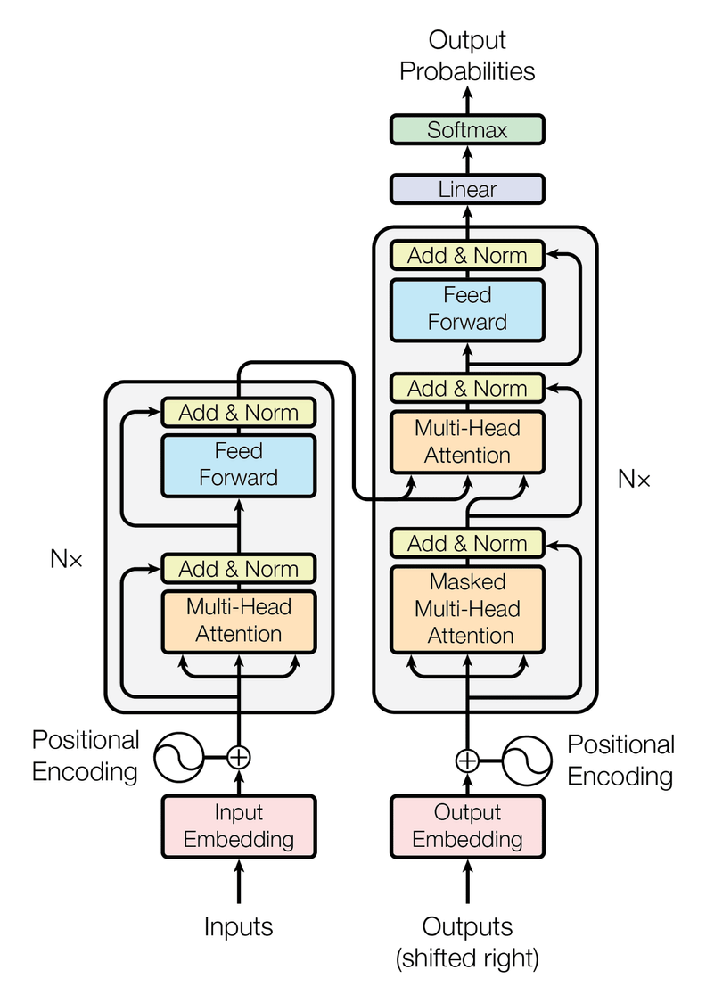
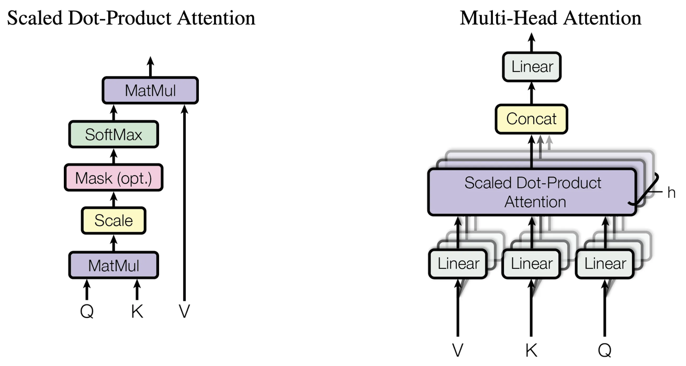
DESCRIPTION OF THE MODELS
TRANSFORMER
IMAGE REFERENCE: [1]

Slide 6
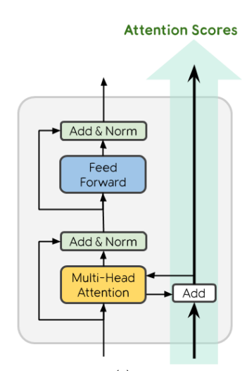



DESCRIPTION OF THE MODELS
REALFORMER
IMAGE REFERENCE: [2]

Slide 7
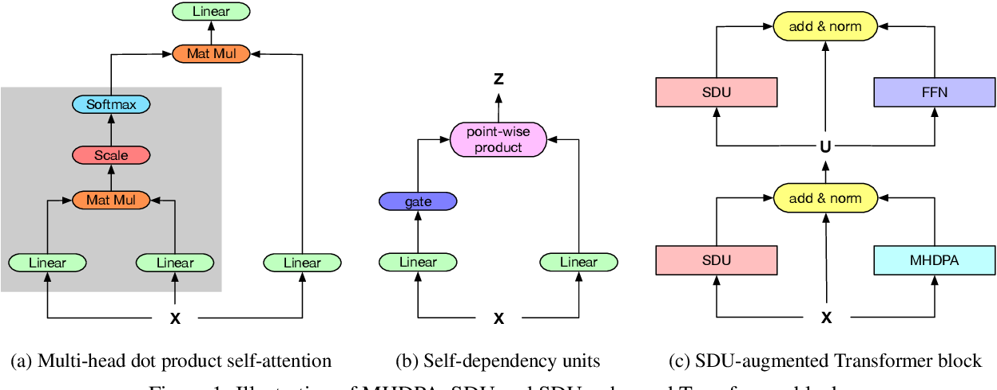

DESCRIPTION OF THE MODELS
HIGHWAY TRANSFORMER (SDU)
IMAGE REFERENCE: [3]

Slide 8


DESCRIPTION OF THE MODELS
PROBLEM WITH SDU
IMAGE REFERENCE: [3]

Slide 9
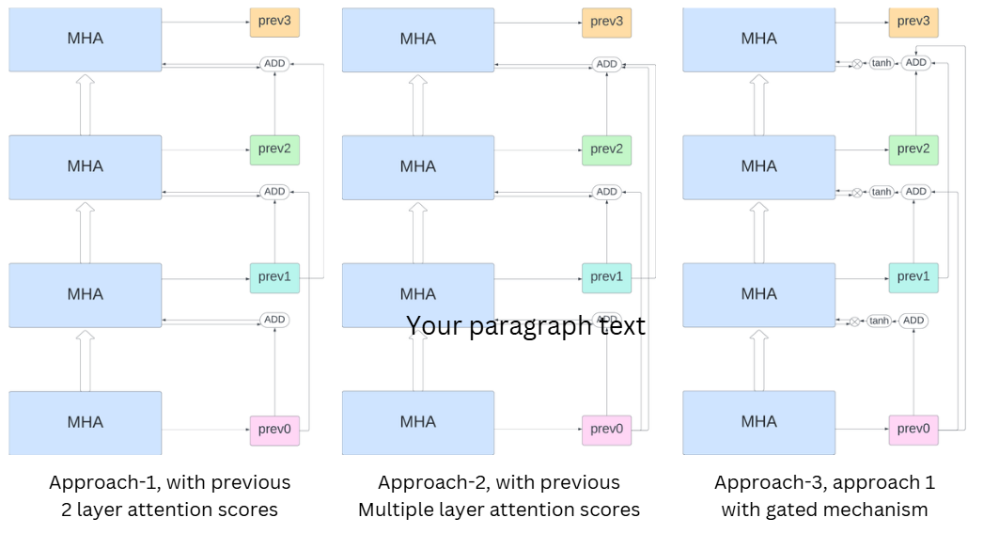
DESCRIPTION OF THE MODELS
APPROACH - 1 & 2

Slide 10

DESCRIPTION OF THE MODELS
APPROACH - 3

Slide 11
DATASET COLLECTION
International Workshop on Spoken Language Translation.
IWSLT TED Talks (Pt-En) Dataset: A parallel corpus of Portuguese-English translations collected from TED Talks, used for machine translation tasks. It contains preprocessed sentence pairs aligned for training, validation, and testing in low-resource translation scenarios.

Slide 12
DATA ANALYSIS
Total number of sentence pairs - 52978
Train-Test split ration 97.5% - 2.5%
Train set sentence pair count - 51785
Validation sentence pair count - 1193
Vocabulary Size
English - 27640
Portuguese - 39468
Tokenizer - SentencePiece
Top frequent words as vocab size - 8500

Slide 13
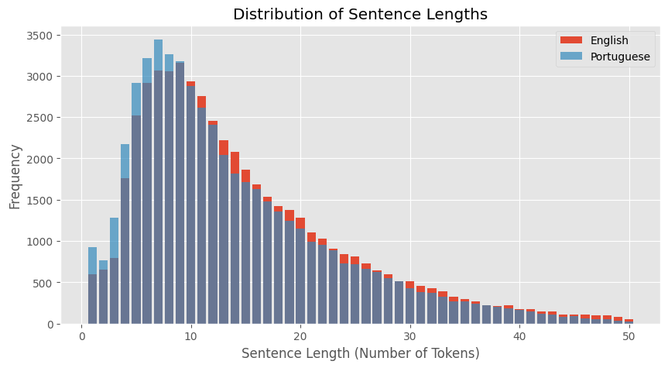
SENTENCE LENGTH DISTRIBUTION

Slide 14









1
d_model - the input dimensionality after time series embedding
HYPER-PARAMETER CONFIGURATION
2
dff - dimension of the feed-forward neural network
3
num_layers - Total number of Encoder/Decoder Layers
d_model
512
dff
2048
4
dropout_rate - set a proportion of units in the network to zeros
num_layers
4
6
5
num_heads - number of heads per Multi-head attention mechanism
dropout_rate
0.1
num_heads
6
8
6
BATCH_SIZE - number of input sequences processed at a time
BATCH _SIZE
128
7
MAX_TOKENS - maximum length of a sentence after tokenization
MAX_TOKENS
64

Slide 15



MODEL EVALUTAION METRICS
BLEU Score (Bilingual Evaluation Understudy)
Sparsity Analysis
A metric that evaluates machine translation quality by measuring n-gram overlap between the generated text and reference translations.
Evaluating the proportion of zeros or close to zeros in a model's parameters or activations to assess efficiency.

Slide 16
MODEL EFFICIECY OBSERVATION
Training Time
Inference Time
The time required to train a model on a dataset, including forward and backward passes.
The time taken by a trained model to make predictions on new data.

Slide 17
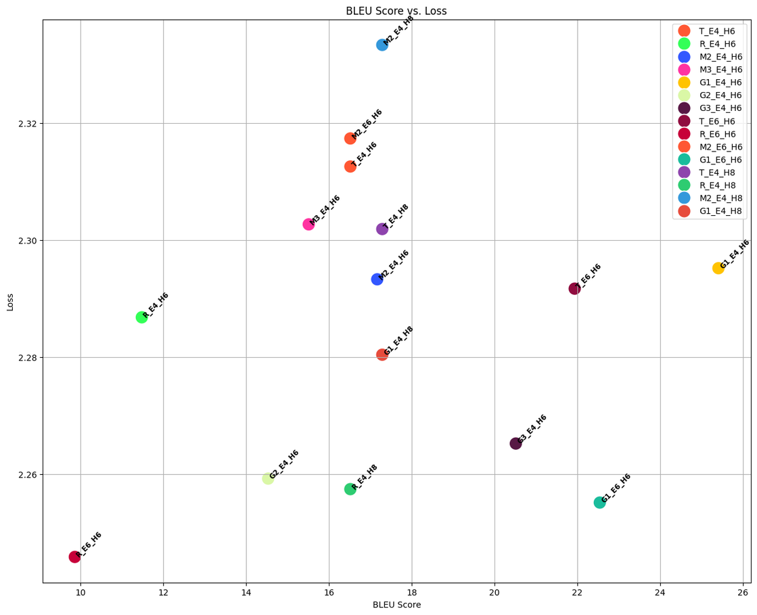
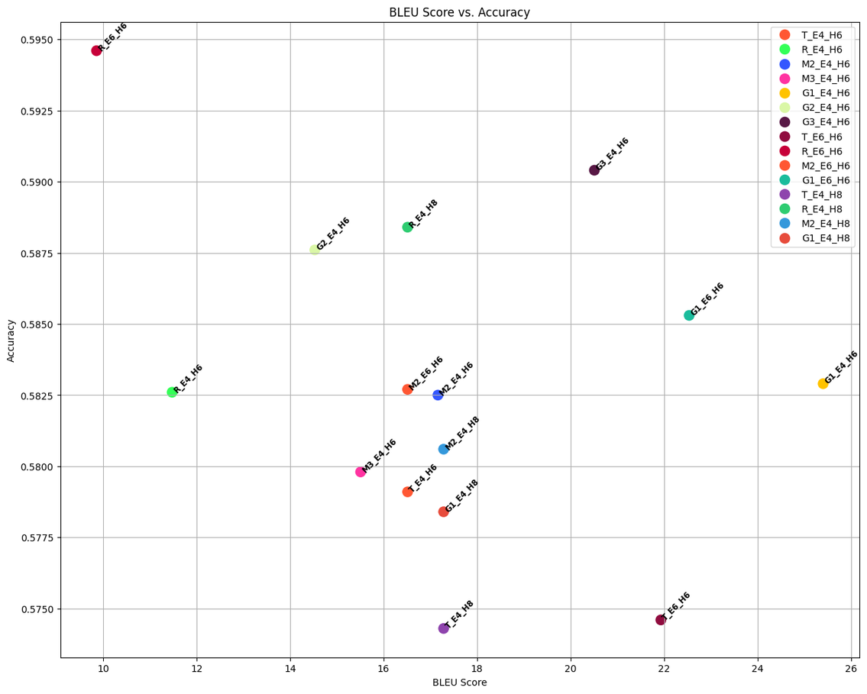
WHY BLEU SCORE
BLEU VS LOSS
BLEU VS ACCURACY

Slide 18
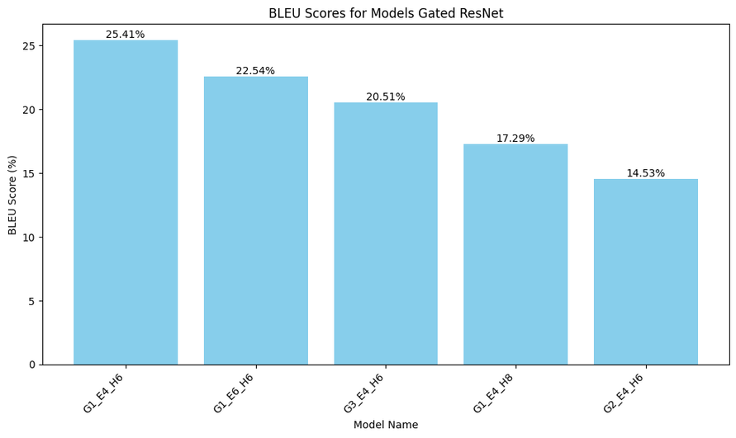
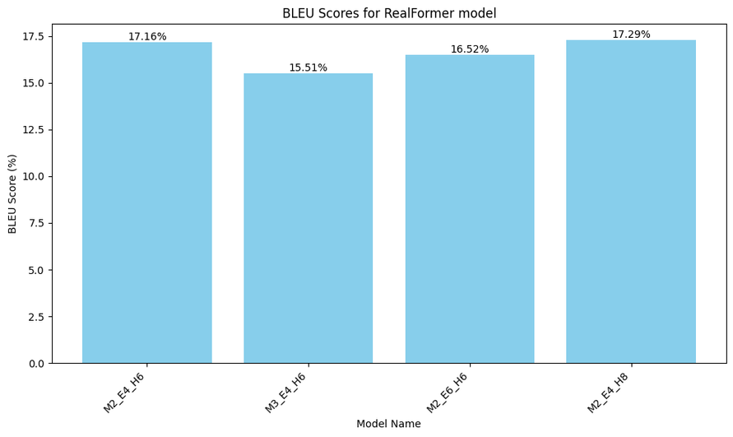
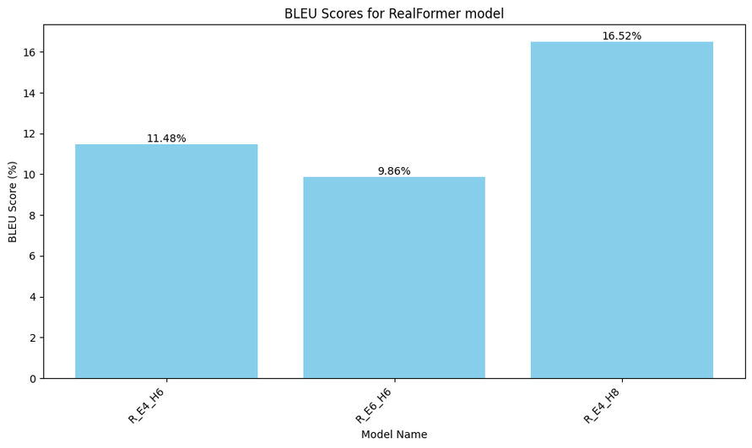
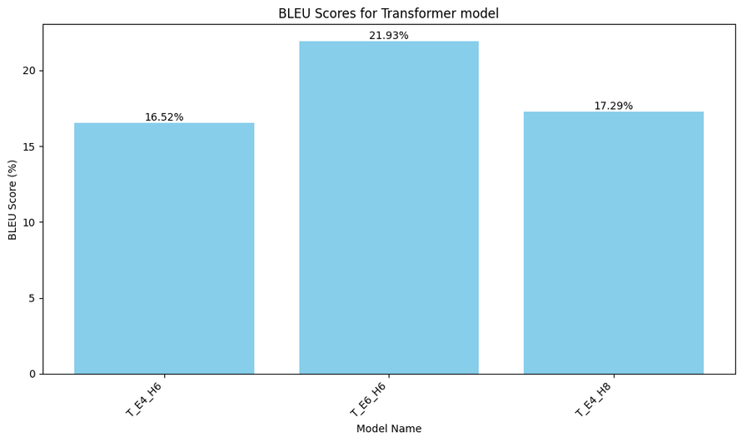
BLEU SCORES ACROSS MULTIPLE RESNET
MULTI
GATED
TRANSFORMER
REALFORMER

Slide 19
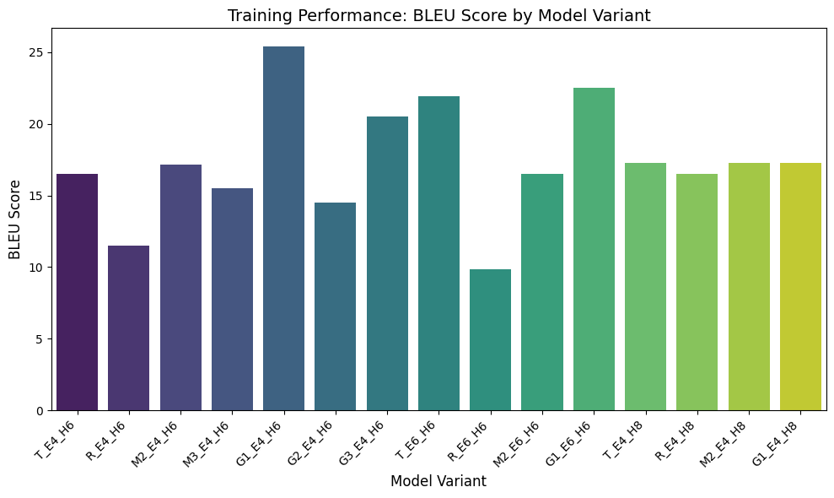
BLEU SCORES

Slide 20
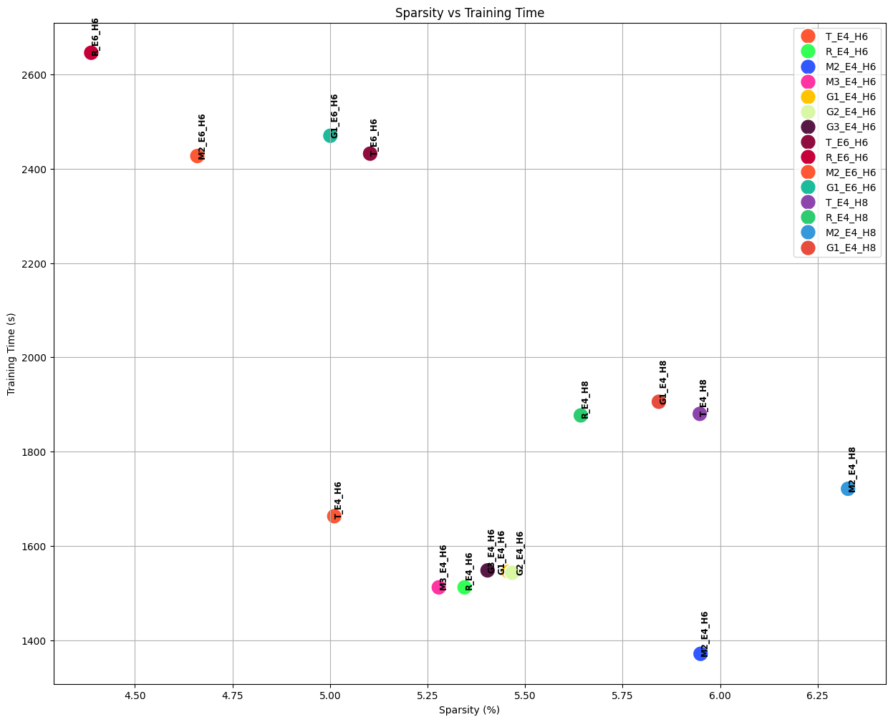
SPARSITY VS TRAINING TIME

Slide 21
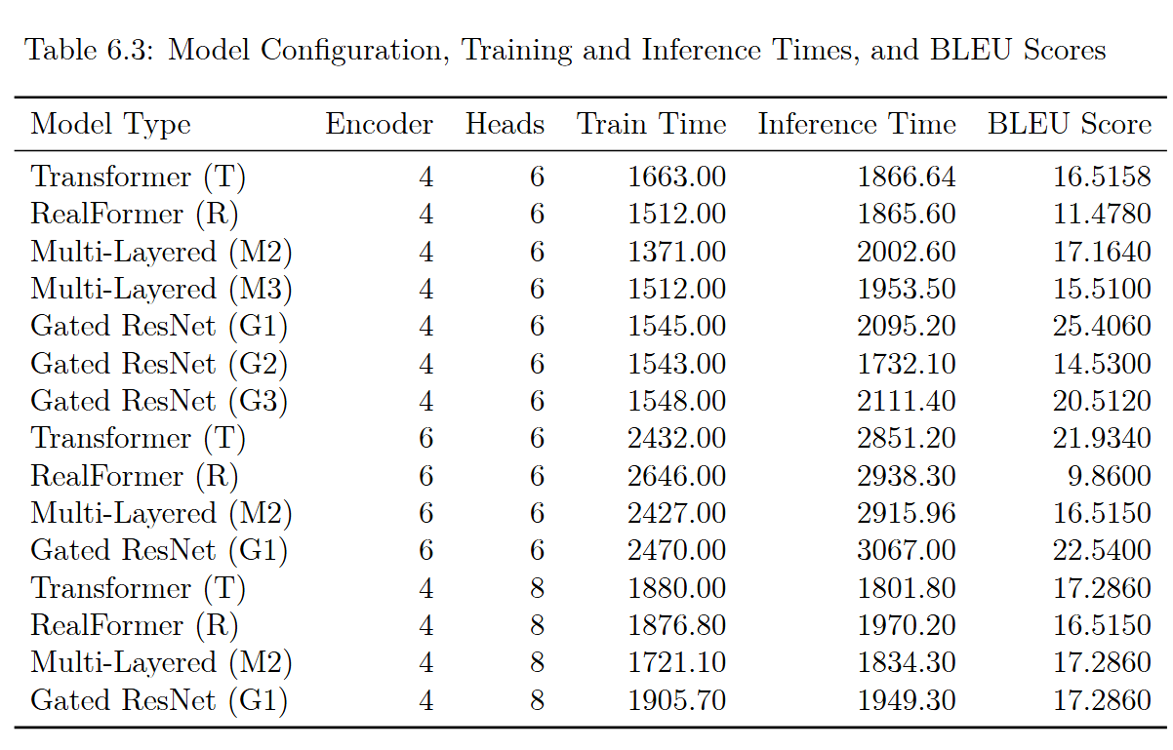
MODEL EFFICIENCY AND INFERENCE TIME

Slide 22
BRAC UNIVERSITY
LIMITATIONS
EXPERIMENTAL LIMITATIONS
COMPUTATIONAL RESOURCES
Dataset Size
Evaluation Metrics
Generalization Across Domains
MODEL LIMITATIONS
Inference Time
Gating Mechanism

Slide 23
BRAC UNIVERSITY
FUTURE RESEARCH
Efficient Gating Mechanism
Generalization Across Domains
Dynamic Gating Mechanism
Where i = [0 to N-1]
Scalability

Slide 24
BRAC UNIVERSITY
CONCLUSION
NOVEL TRANSFORMER VARIANT WITH BETTER PERFORMANCE
UNDERSTOOD THE EFFECT OF RESIDUAL CONNECTION IN MT TASK
GRANT
GATED RESIDUAL ATTENTION NETWORK TRANSFORMER

Slide 25

THANK YOU
FOR THE ATTENTION
REFERENCE
Vaswani, A., Shazeer, N., Parmar, N., Uszkoreit, J., Jones, L., Gomez, A. N., Kaiser, Ł., & Polosukhin, I. (2017). Attention is all you need. Advances in Neural Information Processing Systems, 30. https://doi.org/10.48550/arXiv.1706.03762
He, J., Xia, Y., Qin, T., Wang, L., & Liu, T.-Y. (2021). RealFormer: Transformer likes residual attention. Advances in Neural Information Processing Systems, 34. https://doi.org/10.48550/arXiv.2012.11747
Fan, Z., Zhai, S., Lee, W.-S., & Chua, T.-S. (2020). Highway Transformer: Self-gating enhanced self-attentive networks. Proceedings of the 2020 Conference on Empirical Methods in Natural Language Processing (EMNLP), 1046–1059. https://doi.org/10.18653/v1/2020.emnlp-main.80

